Slide 1
Combination Circuits and Voltage Dividers

Slide 2
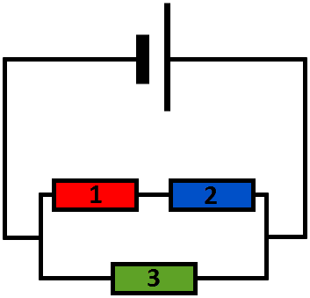
In this Smart Lesson you will learn to:
Recall what a combination circuit is.
Identify Thévenin's Theorem.
Explain the use of voltage dividers.
Solve resistance calculations in parallel and series circuits.

Slide 3
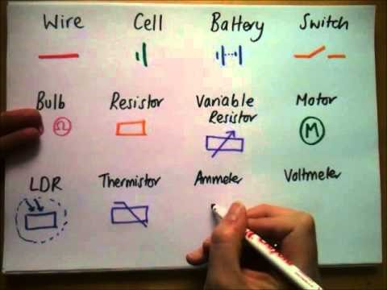

Slide 4
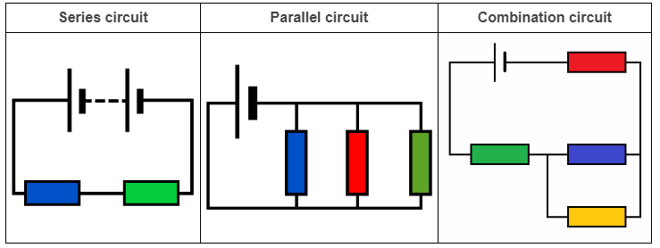
Types of circuit.
When all components are connected in series, the circuit is described as a series circuit.
When all components are connected in parallel, the circuit is described as a parallel circuit.
When you have both components connected in series and in parallel, the circuit is described as a combination circuit. The more components you have, the more connections there are between them, and the more complex the circuit becomes.

Slide 5
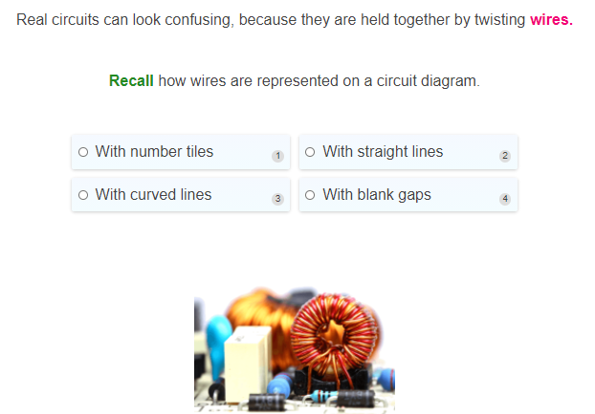

Slide 6
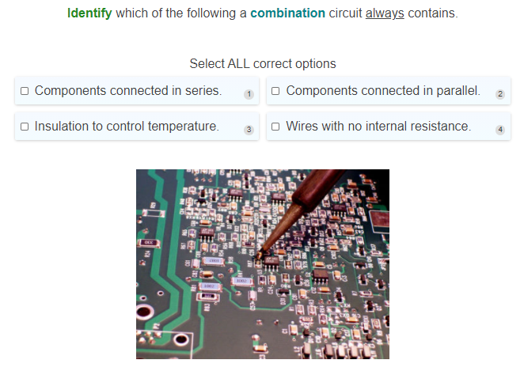

Slide 7
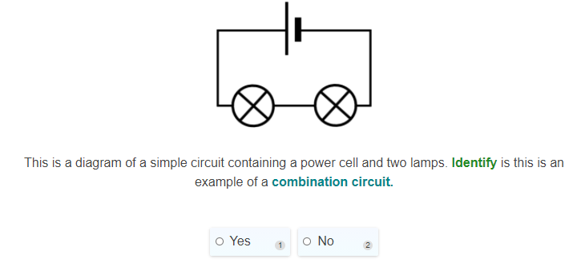

Slide 8
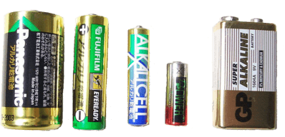
Every circuit, no matter how simple or complicated, needs a source of power to push electrons around it.
A battery is a very common example of a power source. It provides a "push" called electromotive force (emf). This is not really a force - it's a measure of potential difference.
The current (flow of charge) in a circuit can be controlled by a switch, or by other components like resistors. We call such a component a load. The wires that carry current have a small effect on the current as well, but they are designed to give minimum interference.

Slide 9

Thévenin's Theorem.
Real circuits, like you find in a TV remote or a hard drive, can look very complicated. They contain many tiny components, connected by a bewildering web of wires. Luckily, any circuit can be reduced to a simpler form according to Thévenin's Theorem.
Léon Charles Thévenin worked as a telegraph engineer in the 1880s. His great brainwave was to take Ohm's Law and extend it to more complex circuits, with any number of components.
Thévenin's Theorem states that any DC (Direct Current) circuit, no matter how many power sources or loads it contains, can be reduced to a simple equivalent circuit. This equivalent circuit contains one source and one load, which have the combined effects of all the sources and loads in the real circuit.

Slide 10
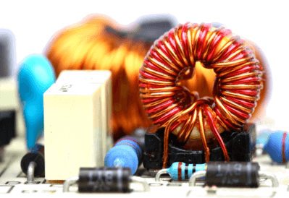

Basically, the theory says that this...

Slide 11
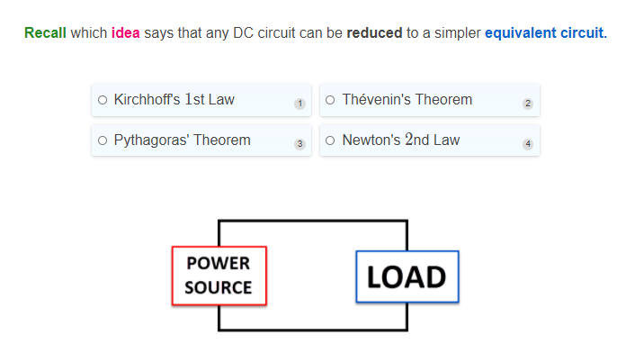

Slide 12
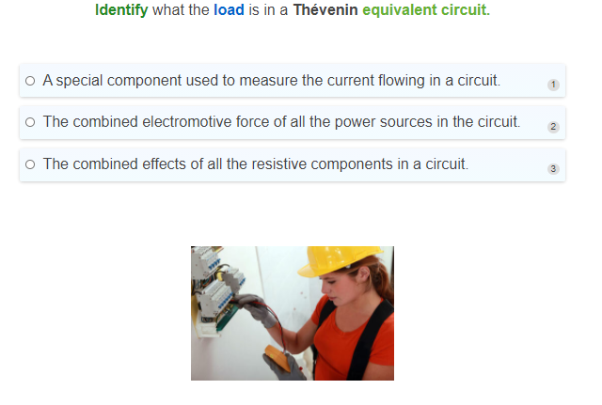

Slide 13
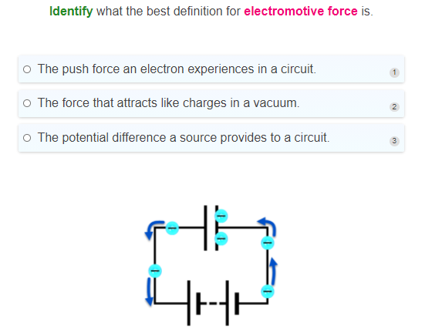

Slide 14
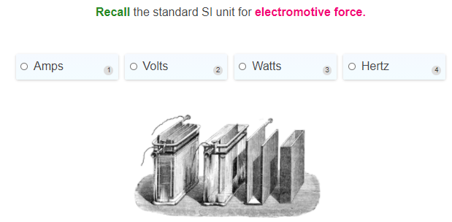

Slide 15
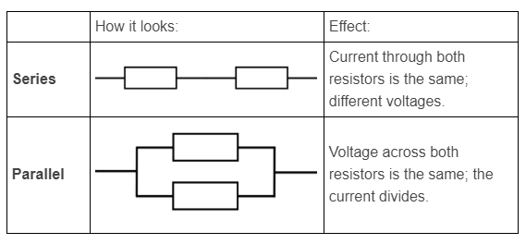
Now we're going to learn how to simplify a circuit mathematically.
There are two key terms you need to get familiar with: series and parallel. They are illustrated below using resistors.

Slide 16
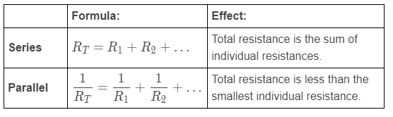
Simplifying resistance.
Whether multiple resistors are in series or parallel with each other affects how we do calculations with them. The total or combined resistance (R_{T}​) of two or more individual resistors can be found by using the formulae in the table below.

Slide 17
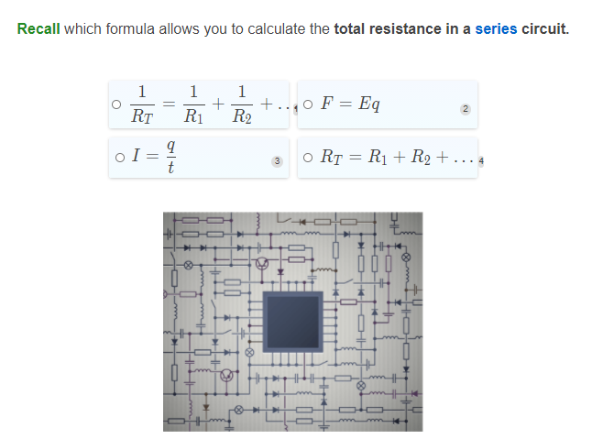

Slide 18
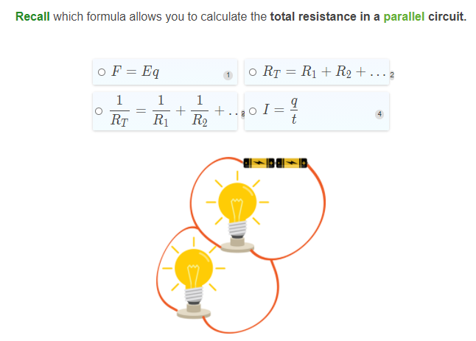

Slide 19
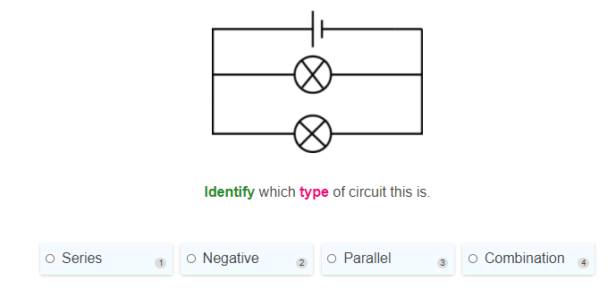

Slide 20
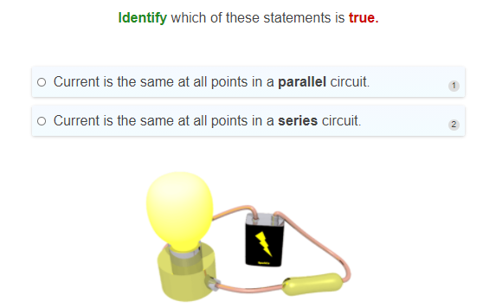

Slide 21
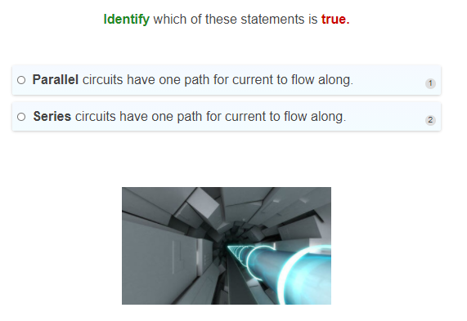

Slide 22
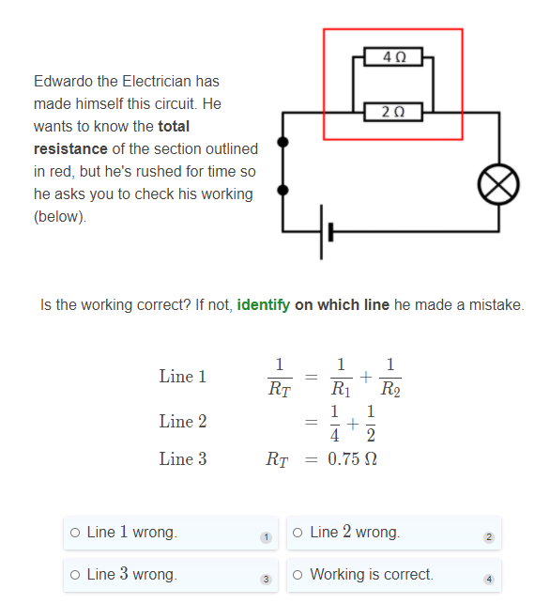

Slide 23
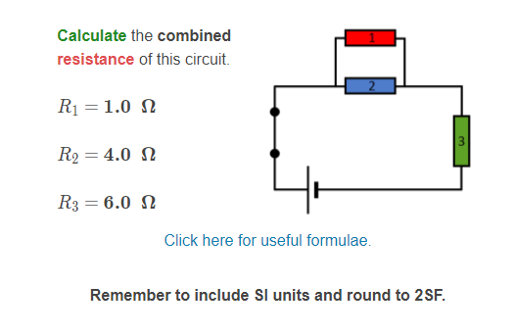

Slide 24
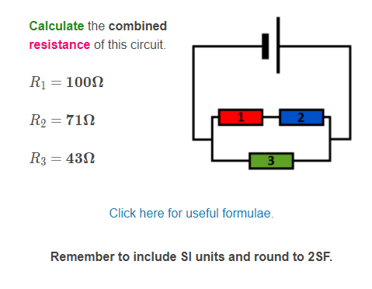

Slide 25
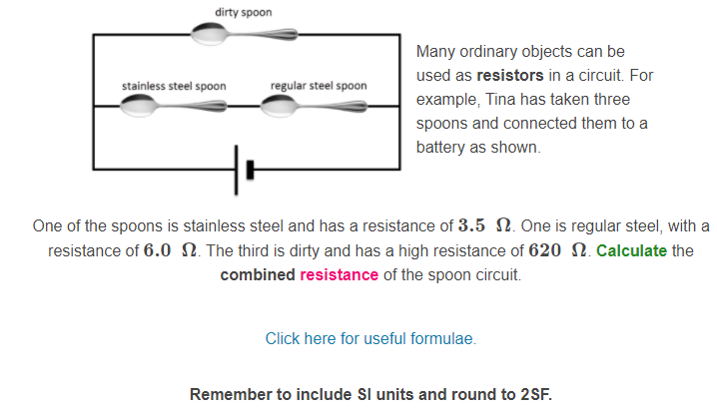

Slide 26
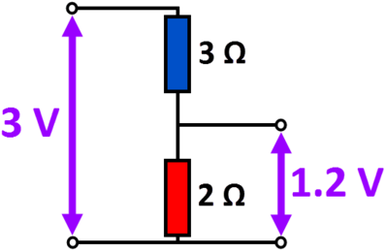
A voltage divider takes advantage of the properties of resistors placed in series.
If you have two resistors in series, they experience the same current, but the potential difference is divided between them.
Suppose we have a blue 3Ω resistor and a red 2Ω one, which you can see on this diagram. Current is delivered to them by a 3 V power cell. But if we measure the voltage across the red resistor, it is just 1.2 V - it has been reduced.
This is an example of a simple voltage divider, which can be used to reduce the potential difference across part of a circuit. It is useful when your cell or battery provides more power than you actually need. In the example above, the difference comes from the energy consumed by the blue resistor.

Slide 27
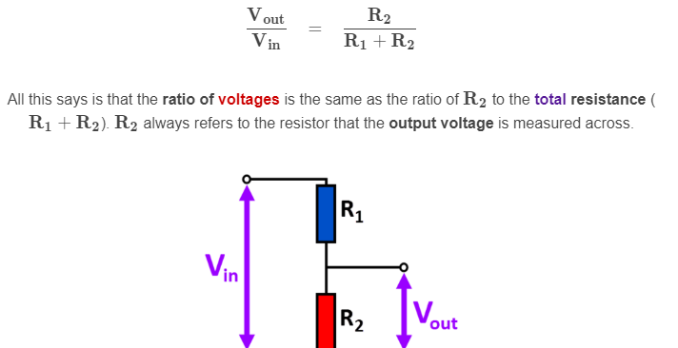
How can you calculate the voltage across different components?
In the previous example, we had a 3 V input and got a smaller output of 1.2 V. Why that amount? It's to do with the proportions of the two resistances.
Using Ohm's Law and Thévenin's Theorem it is possible to derive this equation:

Slide 28
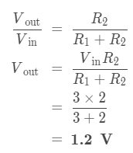
Let's use this to check the numbers in the example.
In our example, R₁​ is the blue resistor and R₂​ is the red resistor, across which we measure the reduced output voltage (V_{out​}). Below is an example calculation to show you how we got the output value of 1.2 V:

Slide 29
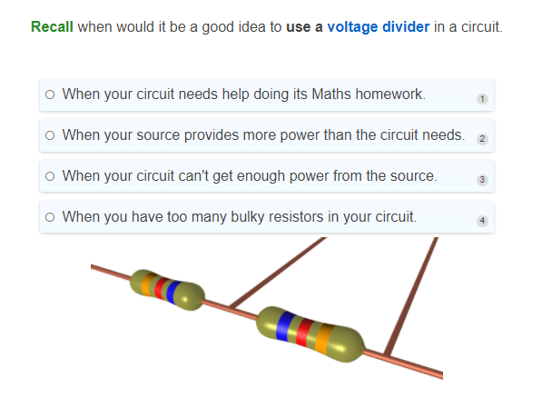

Slide 30
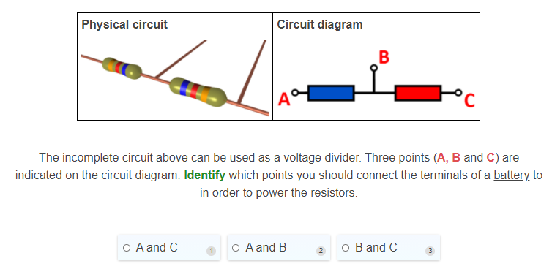

Slide 31
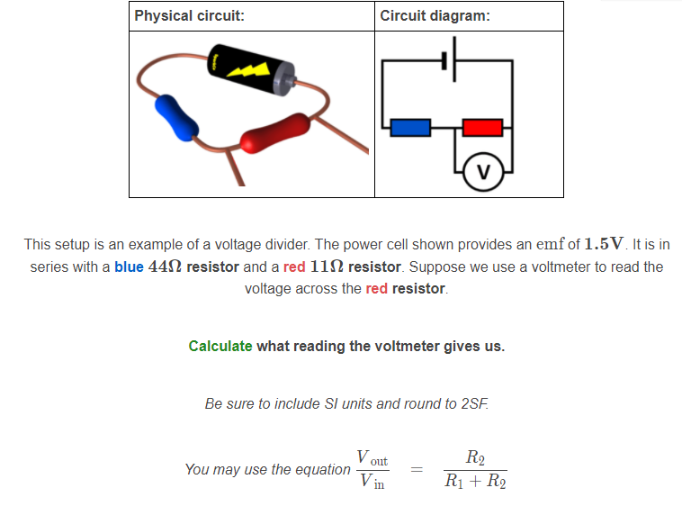

Slide 32
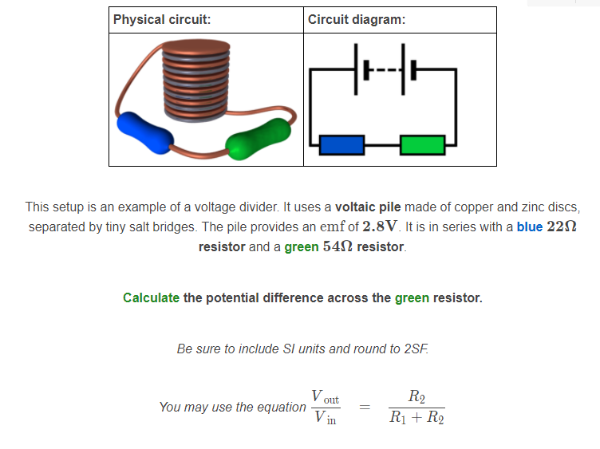

Slide 33
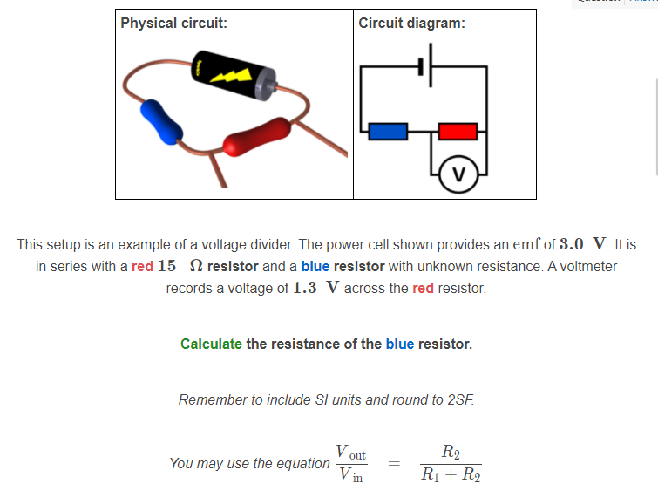

Slide 34
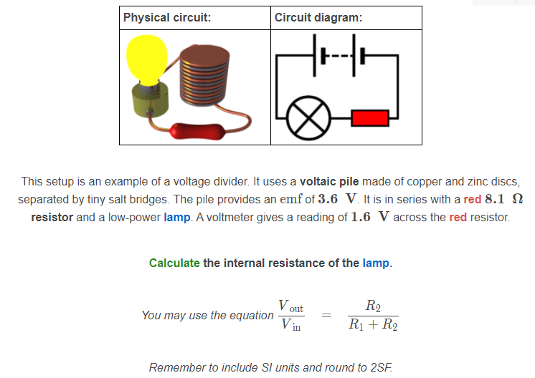

Slide 35
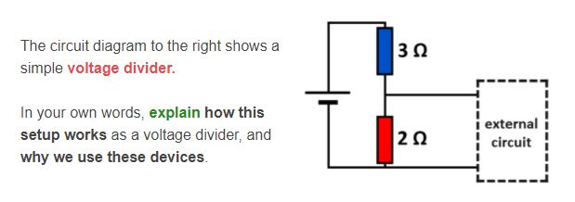

Slide 36
